Slide 1
6MMCS002W Digital Marketing, Social Media & Web Analytics
Weeks 3 –Search engine optimization techniques part A
Dr Vassiliki Bouki, M. Margeti
boukiv@wmin.ac.uk

Slide 2
Content of today’s lecture SEO – part A
Intro to SEO; Organic and paid results of a search engine
On-site and off-site SEO techniques
SEO techniques:
1. Keywords and site content [on-site SEO]
2. Site organization and technical SEO [on-site SEO]
3. Backlinks (external links) [off-site SEO]
1. Keywords and site content – in details
Process
Step 1 (S1): understand keywords and keywords’ elements
Step 2 (S2): Brainstorm
Step 3 (S3): Evaluate your keywords
Step 4 (S4): Categorize keywords.
Step 5 (S5): Develop your content
Tools that can help to decside and evaluate keywords
Problems with the use of ‘keywords’ – ‘keyword density’ – ‘PANDA algorithm

Slide 3
What is SEO?
Search Engine Optimization (SEO): ‘Once highly specialized task relegated to the backroom of a website development team is now a mainstream marketing activity’.
(from ‘The Art of SEO’)
SEO = how to let search engines (and audience) know about your website
SEO Goals:
Visibility of the site
Traffic of the site
Return Of Investment (ROI) – SEO works hand-in-hand with Analytics
HOW could your site appear in search results?

Slide 4
Search results: Organic vs Paid
There are two kinds of results you get from a search engine:
‘Organic’ and ‘Paid’ results
‘Organic’ results: results produced ‘directly’ by a search engine – the web page listings that are produced by a search engine and most closely match user’s query.
‘Paid’ results → advertisements
Why should you want to rank first in ‘organic’ results (but not necessarily in ‘paid’ results)?

Slide 5
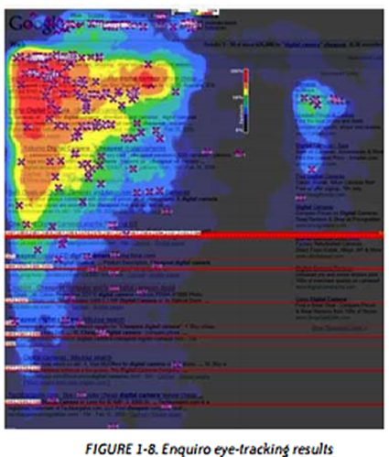
Ranking first...
Eye-tracking results from the book ‘The Art of SEO’ (p.15)

Slide 6
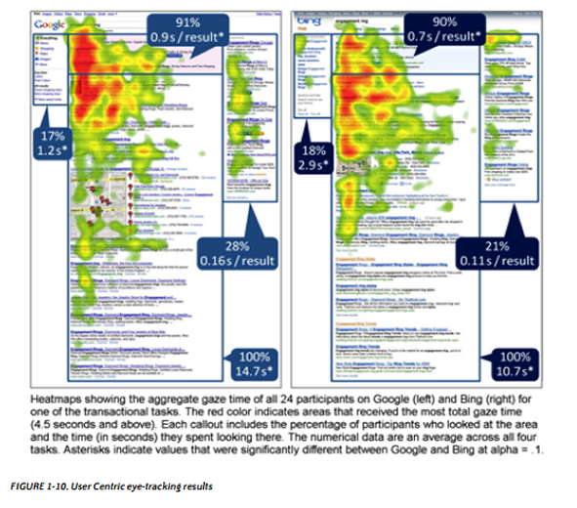
Ranking first...
Eye-tracking results from the book ‘The Art of SEO’ (p.16)
‘Ranking first’ – how could we achieve it?

Slide 7
Let’s look back...
With the enormous expansion of the web the last 18 years SEO evolved from a relatively basic activity to a real ‘art’!
Google started in 1998 (4th of September!) [Apparently, SEO is not related with Google only, but Google is one of the key players].
Thousand of updates since then.
Those days things were relatively easy.

Slide 8
‘Primitive’ methods used for SEO
2000-2010: Most common SEO techniques
Keywords
Keyword density (how often a keyword appears in a page)
Links
Meta – tags (descriptors added at the HEAD of HTML pages)
Doorway Pages (bad…)

Slide 9
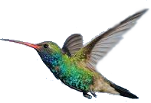
2011 till today
2011: Panda (3 updates February, April and September – keywords, content)
Also in 2011; personalized results; how does your site rank? How do you know?
2012: Penguin (April 2013 – spam links. Sites were degraded / devaluated)
2013: Penguin 2.0 (May 2013 – authorship, social media)
2013-2015: Hummingbird (Sept. 2013... Rewriting of the main code)

Slide 10
SEO
Did ‘primitive’ techniques disappear?
No...the question is how we implement those techniques.
In the past the main question was about of ‘quantity’ (e.g. quantity of links; quantity of content etc) – now it is more about quality.

Slide 11
SEO: Introductory remarks
DEVELOPER → creates a site for the ‘Majestic hotel in London’
USER → is looking for ‘hotels in London’
Developer and user are met through language.
How will the search engine relate what the user types with the content of a web site?
The search engine
must ‘connect’ those two

Slide 12
SEO: Introductory remarks
A search engine will make the semantic and thematic connection between the keyword a user types and the content of the website. Search engine ranks the relevance of your website’s content to the user’s keywords by evaluating numerous factors which depend mainly on:
How your content is written (its quality)
How your content is organized and implemented
How/What other websites around the Internet are linked to you (backlinks)
How ‘local’ is your business to user’s keywords
Notes:
Based on Bill Slawski, http://www.seobythesea.com/2013/09/google-hummingbird-patent/:
User types: “What is the best place in Chicago to find and eat Chicago deep dish style pizza?”
Google’s algorithm Hummingbird understands that user is really looking for a ‘restaurant’ and not a ‘place’. It handles conversational searches

Slide 13
SEO: Introductory remarks
A search engine will consider these factors in long and complex algorithms.
These algorithms are not public, although there are some information about them (e.g. their name; how often they update or refresh).
Why not? The main reasons:
Business interests (other search engines)
So, they are not ‘abused’ (more about ‘abuse’, next week)
Notes:
Algorithms: computer programs that look for clues to give you back exactly what you want (see: http://www.google.com/insidesearch/howsearchworks/algorithms.html)
Ranking factors: we can conduct SEO experiments to figure the weight of each factor, but we don’t know really the exact weighting!
There are indications that Google uses more than 200 factors!
Update means engineers change the criteria of the algorithms
Refreshing means they look again on all websites to see whether something has changed, hence ranking is changing.
Based on Maria Haynes (http://moz.com/blog/google-algorithm-cheat-sheet-panda-penguin-hummingbird), Neil Patel (http://neilpatel.com/2015/02/17/the-ultimate-google-algorithm-cheat-sheet/) and Google (https://googlewebmastercentral.blogspot.co.uk/)
here are some useful information about some of Google’s algorithms:
Algorithms now change very frequently. So, the rank of the website can change as well more frequently, which means monitoring frequently the SEO of website.
Some of these algorithms are:
Hummingbird
Understands better user’s queries which use a more natural language.
It allows people to search using more natural language and not just key-phrases.
Instead of typing: “cheapest baby pram London”, you can type: “Where can I buy the cheapest baby pram in London?”
To rank well for it: Produce content which answers users’ questions; and in general write ‘natural’ content which reads conversationally.
For example, headings should be written in a more descriptive and conversational and natural style: Instead of ‘Improve ranking with long-tailed keywords’, you can have as heading: ‘How to rank higher using long-tail keywords?’
Another, FAQ section should answer users’ queries, and be written in a conversational natural tone.
It adds more strength to long-tailed keywords. Research relevant long-tailed keywords and use them in content and code.
An example, based on Bill Slawski, http://www.seobythesea.com/2013/09/google-hummingbird-patent/:
User types: “What is the best place in Chicago to find and eat Chicago deep dish style pizza?”
Google’s algorithm Hummingbird understands that user is really looking for a ‘restaurant’ and not a ‘place’
Pigeon
It concerns the local ranking.
It is useful for user and local business and especially small businesses
How to rank well for Pigeon – Some tips
full business details should be on footer
physical location of business should be clearly listed on key pages
social media should strongly emphasise the same NAP (name, address, phone number) as website
selection of keywords/keyphrases for webpages should highlight both location and your business area
website should be linked to any local review of your business or high quality local directories.
owner of business should target local backlink-building
Google Map and Google Local
Sources
http://blog.positiveadvertising.co.uk/Posts/Be-Smart/Beware-The-Pigeon-Could-Compromise-Your-Local-SEO-Efforts-/2694
http://blog.red-website-design.co.uk/2015/03/09/google-pigeon-the-update-that-could-massively-improve-your-local-seo/
http://blog.tamar.com/2016/10/zoogle-googles-algorithm-menagerie-3-pigeon/
PANDA
It checks the quality of the website. It rewards the high-quality websites and demotes the low quality websites.
One can realise this when a website doesn’t rank well according to its keywords, or when traffic coming from search engines is decreased.
Panda is not checking whether owner of website has misused or abused backlinks
It can affect the whole website or part of the website.
How:
Apparently there is an army of human website reviewers (their guidelines were leaked: www.google.com/en//insidesearch/howsearchworks/assets/searchqualityevaluatorguidelines.pdf),
also algorithm is looking into the content of a page in terms of keyword stuffing and the stats of website (e.g. bounce rate and how long users spent on it).
Some criteria for quality:
Expertise: Whether the person behind the information is an expert
Security/Trust: Whether users feel that they can part with their credit card details without any problems
Quality of writing regarding copy: Spelling, factual errors, grammar, coherence
Originality of content
Quality control (e.g. has it been reviewed or edited?)
Whether there is excessive amount of ads
Whether it gives in-depth and useful information (e.g. interesting, gives a solution to a problem)
Freshness (great importance is placed on how recent content is or how often is updated)
User experience? (it seems it will be in the near future)
Transparent and detailed content for customers (e.g. Terms and Conditions, Customer service, Privacy police, About us).
So, it doesn’t mean necessarily that all the above factors are calculated algorithmically, it is rather how real-life users would rate the quality of the website.
No one really knows how Google exactly demotes a website according to the quality (and they don’t announce it). However, we know that Panda may punish:
Content farms (‘stealing’ information from other sites or hiring large number of writers to produce text with the sole purpose of ranking well)
Affiliates site (those with no useful information)
Pages with ‘keyword stuffing’
Thin pages: If most pages of website have little content (one or two lines)
Duplicate content: (e.g. If you are not really the creator of the content and you populate your article from other sources, or duplicate your own content just to make it longer)
Use of canonical tag for e-commerce websites prevents this (we will talk more about it in next lecture)
Other sources regarding Panda:
https://www.searchenginejournal.com/seo-guide/panda-penguin-hummingbird/
https://sites.google.com/site/recoverfrompenalty/how-to-recover-from-panda
http://www.hobo-web.co.uk/how-to-write-seo-friendly-website-content-for-google/
http://www.hobo-web.co.uk/google-panda-making-high-quality-websites-in-2015/
https://googlewebmastercentral.blogspot.co.uk/2011/05/more-guidance-on-building-high-quality.html
Penguin
It punishes the website which have cheated and created unnatural backlinks (see: https://support.google.com/webmasters/answer/66356?hl=en, and https://support.google.com/webmasters/answer/2700611?hl=en)
Backlink spamming: In the past SEOs have tried to cheat by creating low quality web pages with text which have meaningful anchors, and which would link to their client’s website. Another way would be using forum posts and include anchor links to client’s website.
A new development: It will discover when a backlink has been removed or disavowed in real time. Quicker recovery.
We don’t know exactly what factors are considered in Penguin, but we do know that:
It tries to detect low quality self-made links to your website and check how trustworthy your backlinks are.
If there are a large number of untrustworthy links to your website, then ranking is reduced.
You can ask Google to disavow unnatural links!
But, Penguin is not just about unnatural links but preventing from webspam techniques in general (see: http://www.hiswebmarketing.com/penguin-not-just-about-bad-links)
A Very Old Algorithm
PageRank
One of the oldest algorithms used by Google. Check the paper by Brin and Page regarding PageRank: http://infolab.stanford.edu/~backrub/google.html
“It works by counting the number and quality of links to a page to determine a rough estimate of how important the website is. The underlying assumption is that more important websites are likely to receive more links from other websites”. (source: Google)
It used to be one of the most important algorithms but now after the recent updates of Panda and Penguin, it is simply one of the ranking signals (see: http://www.webseoanalytics.com/blog/page-rank-2014-dead-or-alive/ and http://checkpagerank.net/blog/pagerank/pagerank-is-not-dead.php).
Now it is not only about having ‘quality links’, but also having relevant ones, and also “fighting” unnatural links
There is speculation that it is on its way out (among other things because there is no a recent update), but I believe that for now we can only monitor it
Sources
http://checkpagerank.net/blog/pagerank/pagerank-is-not-dead.php
http://www.wordstream.com/blog/ws/2014/02/25/pagerank

Slide 14
SEO techniques
Today we often talk about ‘on-site’ and ‘off-site’ SEO
‘On-site’ (please complete the definition ...)
‘Off-site’ (please complete the definition ...)
More information, practical advice:
http://www.square2marketing.com/blog/bid/145500/Onsite-vs-Offsite-Search-Engine-Optimization-What-s-The-Right-Mix

Slide 15
SEO techniques
We could identify three major areas / techniques related to SEO:
1. Keywords and site content [on-site SEO]
2. Site organization and technical SEO (domain name; URLs, root domains & sub domains; structure; navigation; internal linking; meta tags – snippets; sitemaps.xml and robots.txt) [on-site SEO]
3. Backlinks (external links) [off-site SEO]
Optimization via social media, would be considered under the ‘backlinks’ technique

Slide 16
SEO: Keywords and Content
Let’s talk about ‘keywords’… What is a keyword?
Several definitions – depend on the point of view
Keyword (from user’s point of view): It is any word or short phrase that will be used to search for a topic (what the user types in search engine’s window).
Keyword (developer’s point of view): It is any word or short phrase you will use to optimise your site; a word or a phrase you would like to appear for, in search results
Keyword (general definition): It is any word or short phrase that describes a website topic or a page.

Slide 17
SEO: Keywords and Content
The main question for the developer/SEO expert is to identify the best keywords that will make the site visible to users who are looking for this site and then build the content of the site around those keywords
TASK: Develop a list of keywords relevant to your site.
Keyword research is about researching and choosing specific keywords or key phrases for your website.
Ask yourself: ‘What keywords would I like my site to rank for’?
NOTE: each page could have different keywords

Slide 18
SEO: Keywords and Content
You try to understand:
What terms people type in search engines
How frequently they do it
How relevant to your business objectives these terms are
How competitive those terms will be to try to rank for
Process
Step 1 (S1): Make sure you understand keywords and keywords’ elements
Step 2 (S2): Brainstorm
Step 3 (S3): Evaluate your keywords by finding ‘search volume’ and ‘competence’
Step 4 (S4): Categorize keywords.
Step 5 (S5): Develop your content around your keywords – develop your own style
Tools

Slide 19
SEO: Keywords and Content – s1: understand keywords
The first keyword ‘book’ is a term that is typed quite frequently – so someone might think that this is a good keyword.
On the other hand we should consider the relevance of the keyword to our website and our business strategy..
We only sell online books. If our keyword is ‘book’ then people who are looking to buy ‘physical’ books we’ll be redirected to our site.
Also we specialise in History books. If our keyword is ‘book’ then people who want to buy all kind of books (eg scientific books) will be redirected to our site.
Finally, the keyword ‘book’ does not make our offer for ‘free books’ visible.

Slide 20
SEO: Keywords and Content – s1: understand keywords
Furthermore, there are several other websites (some huge ones, like ‘Amazon’) that will try to optimize with (rank for) the keyword ‘book’.
As a result, ‘book’ is a very competitive keyword.
Ideally, we should target a keyword/key-phrase, that is
Relevant
Frequently used
NOT competitive
Let’s see what we get if we try a search with:
Book
Book online
Book online free
Book online free history

Slide 21
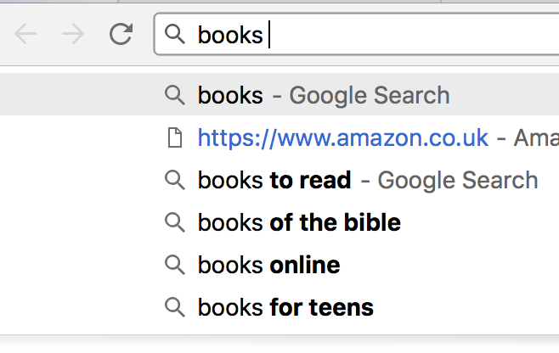
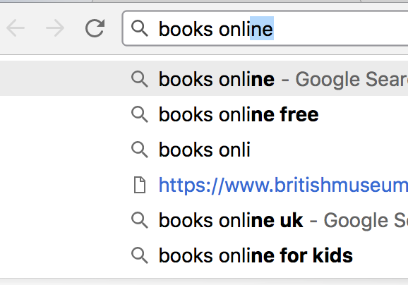
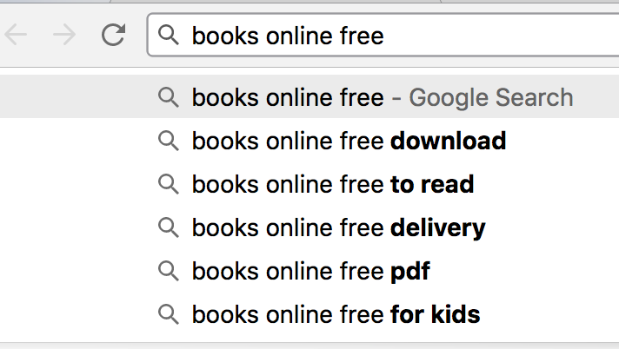
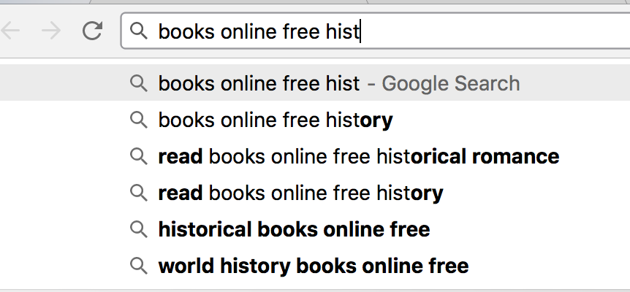
SEO: Keywords and Content – s1: understand keywords
Book
Book online
Book online free
Book online free history

Slide 22
SEO: Keywords and Content – s1: understand keywords
Apparently as you start typing your query in a search engine, the engine tries to make the keyword/phrase/query more specific.
Keyword elements: head | modifier | tail
Head: The focal point of the user’s query and what the rest of the keyword relates to (e.g., Book)
Modifier: a single word that can change the type of search (e.g., book online)
Tail: a word that clarifies or adds further detail to the head term (e.g., history)

Slide 23
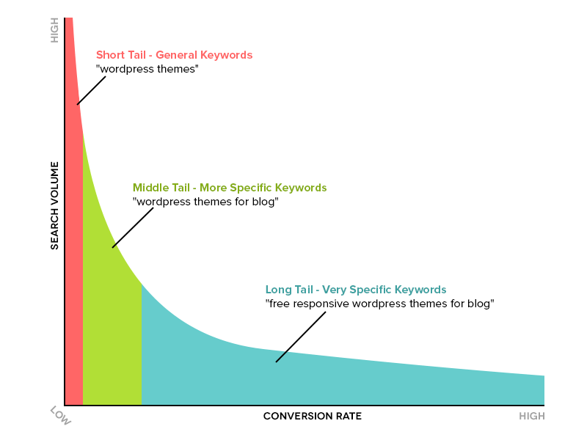
SEO: Keywords and Content – s1: understand keywords
General or specific keywords?
How long should a keyword be?
Relation between keywords and conversion
Source: SEO Pressor
Back to process

Slide 24
SEO: Keywords and Content – s2: Brainstorm
Brainstorm – create a list with potential keywords
Think what services or products you provide and then what kind of keywords and phrases a user would use.
Ask yourself the following three questions:
Is the keyword relevant to your website’s content?
Will users find what they are looking for on your website when they search using these keywords?
Will the users be satisfied with what they find?
Back to process

Slide 25
SEO: Keywords and Content – s2: Brainstorm
Do not forget: the way you use to explain your product may not be the way a user uses to find this product.
Example:
You: “high value contents insurance”
User: “cheap home insurance”
Back to process

Slide 26
SEO: Keywords and Content – s3: Evaluate
There are several things you can do, to evaluate your keywords.
What do you want to evaluate:
Keywords lead to the ‘correct’ / expected results
How frequently they are used
How competitive they are

Slide 27

SEO: Keywords and Content – s3: Evaluate
a)
A very simple action you could take in order to find out if your keywords lead to ‘correct’ results, is to use them in a search engine.
What kind of results do they produce?
Are these quality sites?
b) Use online tools to find out how frequently these keywords are used/searched.
keyword volume or search volume: how many people are querying these terms on Google, Yahoo and Bing. Find out how much traffic the keywords you though about get.
Back to process

Slide 28
SEO: Keywords and Content – s3: Evaluate
c) Consider how competitive they are. Do not forget if a keyword is very popular is also very competitive
Tools you can use for (b) and (c) are given in this presentation and tutorials but you can also do your own search.
Back to process

Slide 29
SEO: Keywords and Content – s4: Categorise
‘Categorize keywords’ is the process of grouping keywords into topics or themes
By categorizing keywords, you add meaning and organization to the process of keyword research. It can also lead to something actionable, such as creating popular links on homepages or creating popular pages.

Slide 30
SEO: Keywords and Content – s4: Categorise
Following our previous example: you have a website that sells books specialized in History. You want to find out which products according to publishing house or historical period should be displayed on the home page according to the search volume. So:
You categorize the ‘history books’ keyword according to:
Publishing House (e.g. ‘Penguin’, ‘Oxford University Press’, ‘Cambridge University Press’)
Historical Period (e.g. ancient times, medieval period; first and second world par; golf war)

Slide 31
SEO: Keywords and Content – s4: Categorise
You may form categories such as:
Books World War I (WWI)
Books WWII
Books WWII Oxford University Press
Books Ancient Times
Books Ancient Times Penguin
etc..
When checking the search volume, it may be that ‘Books Ancient Times’ have the highest search volume so you may create a shortcut on home page.
Back to process

Slide 32
SEO: Keywords and Content – s5: Develop your content
CONTENT – it is very important to have quality content in your site.
In order to develop quality content you must know your audience.
Research your target audience and what they want and need
Research what they are discussing and with whom
Define what you want them to do when they visit your website

Slide 33
SEO: Keywords and Content – s5: Develop your content
Define and develop your style
Have a style according to your audience such as: entertaining style, informative style, technical style. For example:
Blog-post style
http://stylebubble.typepad.com/
Comparative style (where you compare products)
http://www.dpreview.com/products/compare/side-by-side?products=canon_eos7d&products=fujifilm_s2800hd
Informative style (where you inform about a product)
http://www.dpreview.com/reviews/canoneos7d/
‘How-to’ guide (where you give instructions)
http://pages.ebay.co.uk/help/sell/questions/list-item.html

Slide 34
SEO: Keywords and Content – s5: Develop your content
Define and develop your style
Be original and bring something exciting, creative, engaging, or humorous, to create content that people will share.
Combine content types (e.g., text with images, animation, and audio). You have plenty of them!
But, design and implement all content types well!
Back to process

Slide 35
SEO: Keywords and Content – useful tools
There are several tools to help you with:
Brainstorming - Getting ideas about what relevant keywords to use
Evaluating - Getting information about the search volume of keywords (what users type most frequently) and the competition (the keywords that the competition uses)
Apart from the tools we suggest here, you can do your own research.

Slide 36
SEO: Keywords and Content – useful tools
Google AdWords Keyword Planner tool:
It shows the competition and the search volume for a keyword and other related keywords
Ideally we want:
low competition (keyword not so used by other companies)
high search volume (keyword to be typed in frequently)
But, relevance is the most important attribute: so it is a way to find a group of relevant long-tail keywords.
You need to be a Google AdWords subscriber.

Slide 37
SEO: Keywords and Content – useful tools
Google Trends and Google Correlate:
Google Trends shows:
the popularity of a keyword over time
events which may have triggered spikes in popularity
regional popularity
other related keywords which people search most often
Google Correlate shows correlations between the pattern of search behavior of our keyword and the pattern of search behavior of other keywords
Visit the following for more information on ‘Google Trends’ and ‘Google Correlate’:
http://www.google.com/trends/correlate/tutorial

Slide 38
SEO: Keywords and Content – s1: understand keywords
Understanding keywords… Let’s consider an example
You just started your internet business that is an online bookstore. Books can be read online. You offer some free books in order to attract customers. You also specialise in history books.
Given the above description, what are the possible keywords?
Book
Online
Free
Histrory
Book
online
free
history

Slide 39
SEO: Keywords and Content – useful tools
‘Keywordtool’:
http://keywordtool.io/
It is similar to AdWords Keyword Planner, in that it will give information about relevant keywords, their search volume and competition (the last two attributes cannot be accessed free of charge).

Slide 40
SEO: Keywords and Content – useful tools
More online free tools.
http://www.wordtracker.com/ (free account; territory search)
http://tools.seobook.com/keyword-tools/seobook/ (free account)
Many paid services e.g.
https://www.rankingcoach.com/en-gb

Slide 41
SEO: Keywords and Content Problems – example
Let’s see an example. Please read the following paragraph carefully – it comes from an article published on the internet. Can you guess what the author is trying to optimize the page for? (the example is from the book ‘SEO 2013 & Beyond, A. Williams).
“Understanding Pomegranate Juice Benefits
Some people may not be that knowledgeable about pomegranate juice benefits but it is actually a very effective source of Vitamin C. The pomegranate fruit contains a lot of healthy nutrients and you can get a lot of good immune system boosters out of pomegranate juice benefits. It can actually provide around 16% of the required amount of Vitamin C that adults need to take on a daily basis. Pomegranate juice benefits” also include Vitamin B5 as well as the antioxidant element of polyphenols and potassium.”

Slide 42
SEO: Keywords and Content Problems – example
Pomegranate Juice Benefits
“Understanding Pomegranate Juice Benefits
Some people may not be that knowledgeable about pomegranate juice benefits but it is actually a very effective source of Vitamin C. The pomegranate fruit contains a lot of healthy nutrients and you can get a lot of good immune system boosters out of pomegranate juice benefits. It can actually provide around 16% of the required amount of Vitamin C that adults need to take on a daily basis. Pomegranate juice benefits also include Vitamin B5 as well as the antioxidant element of polyphenols and potassium.”
What is the issue in the above paragraph???
‘Keywords density’ & Content quality
pomegranate juice benefits
Pomegranate juice benefits

Slide 43
SEO: Keywords and Content Problems – keyword density
Keywords density: Keyword density is the percentage of times a keyword or phrase appears on a web page compared to the total number of words on the page. In the context of search engine optimization keyword density can be used as a factor in determining whether a web page is relevant to a specified keyword or keyword phrase.
In the past web developers tried to ‘cheat’ search engines by increasing the keyword density.
The result was low quality content.

Slide 44
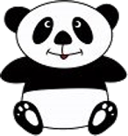
SEO: Keywords and Content Problems – keyword density – PANDA
Google strikes back…
What is ‘Panda’?
Google Panda is a change to Google's search results ranking algorithm that was first released in February 2011. The change aimed to lower the rank of "low-quality sites" or "thin sites" and return higher-quality sites near the top of the search results. (from Wikepedia “ http://en.wikipedia.org/wiki/Google_Panda”)
Mainly ‘panda’ is about keywords and content.
What is the ‘correct’ keyword density ???
http://www.youtube.com/watch?v=Rk4qgQdp2UA

Slide 45
SEO: Keywords and Content Problems – keyword density
There are many online (free and paid) tools that allow you to check websites for keywords density. Example:
https://www.internetmarketingninjas.com/seo-tools/keyword-density/
http://tools.seobook.com/general/keyword-density/
(do your own search to find more similar tools)

Slide 46
Summary
This week we talked about SEO techniques and we examined in details ‘keywords’. More specifically, we talked about:
Organic and paid results of a search engine
On-site and off-site SEO techniques
SEO techniques:
1. Keywords and site content [on-site SEO]
2. Site organization and technical SEO [on-site SEO]
3. Backlinks (external links) [off-site SEO]
1. Keywords and site content – in details
Process
Step 1 (S1): understand keywords and keywords’ elements
Step 2 (S2): Brainstorm
Step 3 (S3): Evaluate your keywords
Step 4 (S4): Categorize keywords.
Step 5 (S5): Develop your content
Tools that can help to decside and evaluate keywords
Problems with the use of ‘keywords’ – ‘keyword density’ – ‘PANDA algorithm

Slide 47
Next Week
Next week we’ll continue with the other SEO techniques that are related to:
2. Site organization and technical SEO (on-site technique)
3. Backlinks (off-site technique)

